Slide 1
Relational Data Model
Lecture 02

Slide 2
Database
The Database Properties :
Centralized repository
Real-time
Concurrent
Interactive (ad-hoc) query

Slide 3
Why DBMSs?
Some of the advantages of Database Management systems:
Data administration
Efficient data access
Data integrity & security
Concurrent access, crash recovery

Slide 4
Data Models
Data modeling simply is a method of describing data or information.
It includes:
Structure of data
In what format data is stored
Operations on Data
Selection
Set of queries to fetch the data
Modification
Operations to modify the database and the data
Constraints
It defines what data can be stored in the database by enforcing rules and limitaions

Slide 5
Why Relational Data Model?
It provides both
Efficient data access
By structuring data
Efficient data manipulation
By providing set of operations

Slide 6
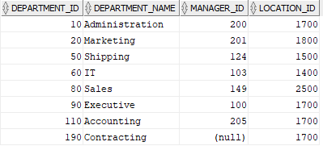
Relational Data Model Basics
The relational model represents data as a two dimensional.
In the relational model, a table is also called a relation.
In the following table
Every row represent a department.
Every column in a row, represent an attribute of that department.
department

Slide 7
Attributes
Columns in a table (relation) are called attributes.
In the following table (department), the attributes are:
Department_id
Department_name
Manager_id
Location_id
department

Slide 8
Schema
A schema represent the name of a relation and its attributes.
DEPARTMENT(department_id,department_name, manager_id,Location_id)
A relational database consists of a set of relations.
A relational database schema is a set of schemas of database relations.

Slide 9
Tuple
In a relation (table), a row (record) is called a tuple.
The following relation (department) has 8 tuples.
The value of each attribute in a tuple represents a component.
department

Slide 10
Domains
In a relational model, each components of a tuple must be atomic. Each component is allowed to be a single value of primitive types (integer, character, character string).
The domain of an attribute (column) is simply the data type of that attribute.
DEPARTMENT(department_id: int,department_name: string, manager_id : int,Location_id: int)

Slide 11
Null Value
Null denotes the absent of a value.
The value of an attribute is null if
It is unknown
It does not exist

Slide 12
Integrity Constraints
Integrity constraints are a set of rules to maintain the quality.
Domain/tuple constraints
Entity integrity constraints
Key constraints
Referential integrity constraints

Slide 13
Domain Integrity Constraint
To retrict the values of tuple attributes in a database relation.
Domain constraints
Define conditions on a single attribute of a tuple
department_id = 60
Tuple constraints
Define conditions on different attributes of a tuple
department_id = 60 and location_id =1700

Slide 14
Keys
A key, in a relation, identifies every tuple uniquely.
A key can be a single attribute or a set of attributes.
In a multi-attribute key, the combinations of key attributes must be unique for each tuple (row) in the relation (table).
In relation department, the key is department_id which is unique for every tuple.
To represent key in a relation, key attributes are underlined.
DEPARTMENT(department_id: int,department_name: string, manager_id : int,Location_id: int)

Slide 15
Entity Integrity Constraint
This constraint ensures that each relation has a primary key.
A primary key is an attribute or set of attributes that uniquely identifies every tuple in a relation.
The values of the attributes involved in the primary key cannot be null.
Attribute department_id is the primary key of relation departments.
DEPARTMENTS(department_id,department_name, manager_id,Location_id)
A primary key is unique and cannot be null.

Slide 16
Referential integrity Constraint
Referential integrity is a constraint specified on two relations.
Referential integrity constraint determines if two relations are related. A value appearing in a column of a relation also appears in a column of another relation.
Location ID exits in relations departments and locations.
Attribute location_id in relation department refers to the location_id attribute in relations locations.
DEPARTMENTS(department_id,department_name, manager_id,Location_id)
LOCATIONS(location_id,street_address,postal_code,city,state_province,country_id)

Slide 17
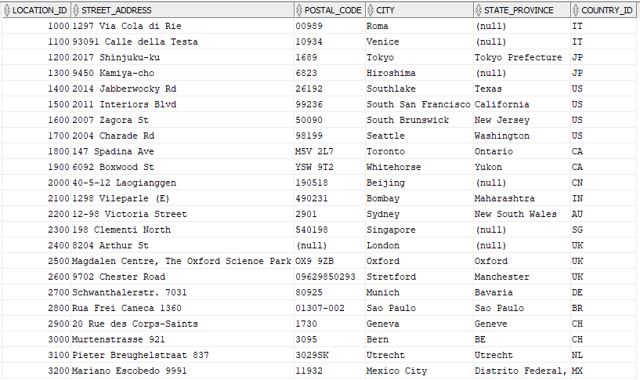
Referential Integrity Constraints
departments
locations

Slide 18
Mathematical Algebra
An algebra is consists of variable and operations.
Simple operations:
addition
subtraction
multiplication
division
(x + 3) * (y – 1)

Slide 19
Relational Algebra
In a relational algebra
Variable are relations
Operations are set of relational operations
Operations take relations as operands. The result of the operations is a relation.
A unary operations
requires a single relations as its operand
A binary operations
Requires two relations as its operands

Slide 20
Relational Operators
Some relational operations:
Selection
Projection
Cartesian product
Rename

Slide 21
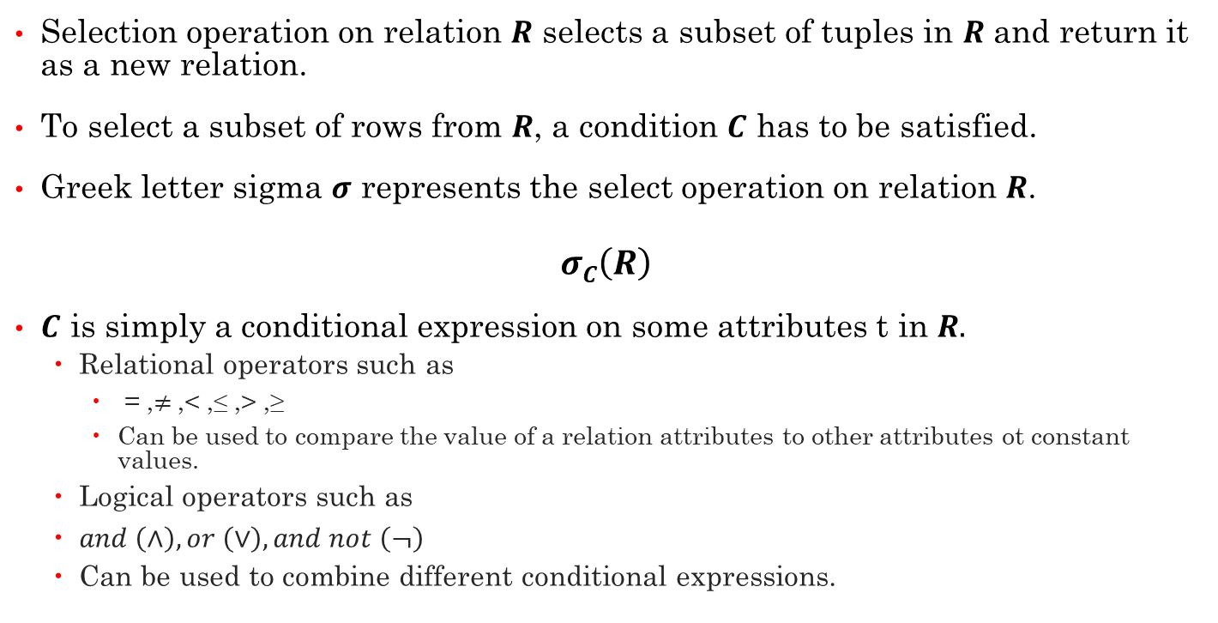
Selection
Selection operation on relation $R$ selects a subset of tuples in $R$ and return it as a new relation.
To select a subset of rows from $R$, a condition $C$ has to be satisfied.
Greek letter sigma $σ$ represents the select operation on relation $R$.
$$σC\left(R\right)$$
$C$ is simply a conditional expression on some attributes t in $R.$
Relational operators such as
= ,$≠$,< ,≤ ,> ,≥
Can be used to compare the value of a relation attributes to other attributes ot constant values.
Logical operators such as
$and \left(∧\right), or \left(∨\right), and not \left(¬\right)$
Can be used to combine different conditional expressions.

Slide 22
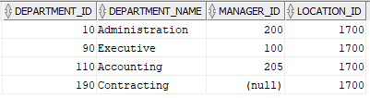

Selection (Example)
Select tuples from relation department where location ID 1700.
The result of the following expression
$$σlocation_id=1700\left(Department\right)$$
is

Slide 23
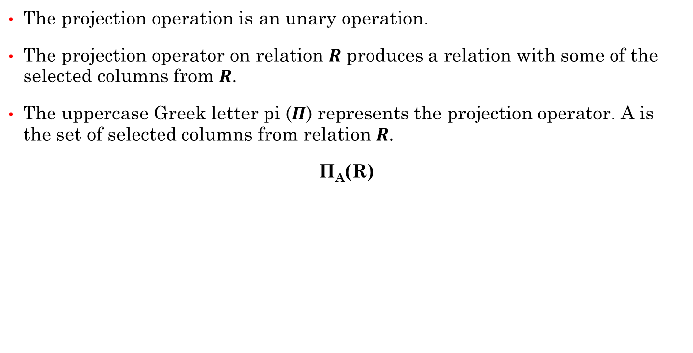
Projection
The projection operation is an unary operation.
The projection operator on relation $R$ produces a relation with some of the selected columns from $R$.
The uppercase Greek letter pi ($Π$) represents the projection operator. A is the set of selected columns from relation $R$.
Π_{A}(R)

Slide 24
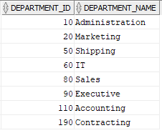
Projection (Example)
Select columns department_id and department_name from relation department.
The expression to select the given columns:
Π_{department_id, department_name}(Department)
The result of the above projection operator is

Slide 25




Cartesian Product
The Cartesian product is a binary operation.
The Cartesian product (cross-product or cross-join) of two relations $R$ and $S$
$$R×S$$
is an operation that combines every row from relation $R$ to all tuples in relation $S$.
$$R×S$$
$$R$$
$$S$$
r.col1 | r.col2 | s.col1 | s.col2
A | 10 | D | 40
A | 10 | E | 50
B | 20 | D | 40
B | 20 | E | 50
C | 30 | D | 40
C | 30 | E | 50
r.col1 | r.col2
A | 10
B | 20
C | 30
s.col1 | s.col2
D | 40
E | 50

Slide 26
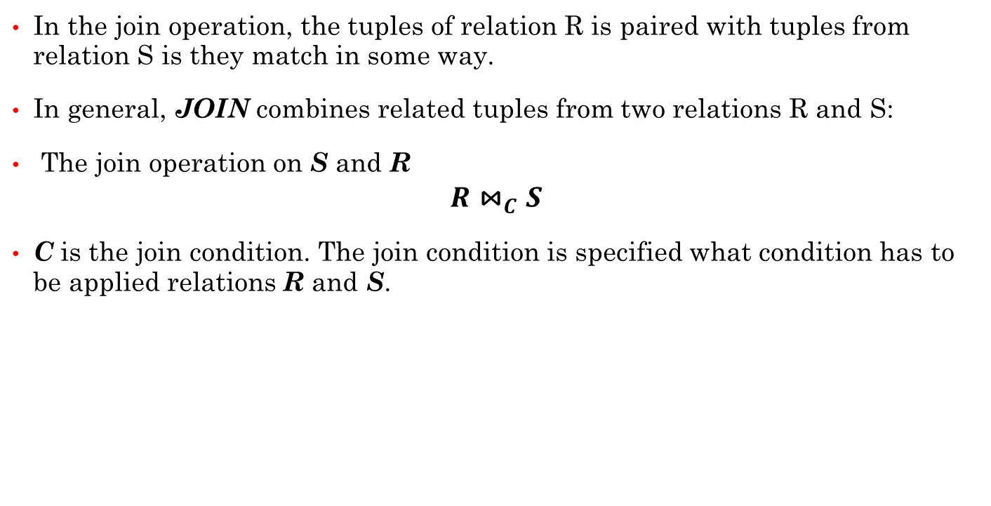
Join
In the join operation, the tuples of relation R is paired with tuples from relation S is they match in some way.
In general, JOIN combines related tuples from two relations R and S:
The join operation on S and R
$$R{\text{⋈}}_{C}S$$
C is the join condition. The join condition is specified what condition has to be applied relations R and S.

Slide 27

Equi-Join
Equi-join applies the equivalence condition. In condition C, the values of attributes from relation R matches the values of attributes from relation S in condition C.
ar is an attribute in relation R
as is an attribute in relation S
$$R{\text{⋈}}_{R.ar=S.as}S$$

Slide 28
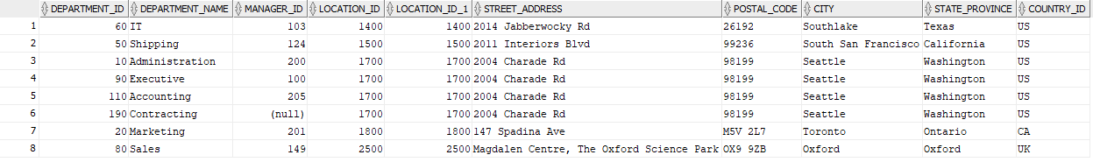

Equi-Join (Example)
Display all departments and their locations.
$departments$ ${\text{⋈}}_{departments.location_id=locations.location_id}locations$
DEPARTMENTS(department_id,department_name, manager_id,Location_id)
LOCATIONS(location_id,street_address,postal_code,city,state_province,country_id)

Slide 29


Combining Operations (Example)
Display department ID and department name for department with ID 60.
Project operation is required to choose the given attribute:
Π_{department_id, department_name}($Department$)
Selection operation is needed to select tuples with depaetrment_id = 60
$σdepartment_id=60\left(Department\right)$
To produce the final result, we need to combine these two operations
Π_{department_id, department_name}($σdepartment_id=60\left(Department\right)$)

Slide 30
Combining Operations (Example)
Display department ID, department name, and city for all departments.
Display department ID, department name, and city for all departments in location ID 1700.
OR
DEPARTMENTS(department_id,department_name, manager_id,Location_id)
LOCATIONS(location_id,street_address,postal_code,city,state_province,country_id)
Πdepartment_id, department_name,city($departments$ ${\text{⋈}}_{departments.location_id=locations.location_id}locations)$
Πdepartment_id, department_name,city($σlocation_id=1700$($departments$ ${\text{⋈}}_{departments.location_id=locations.location_id}locations))$
Πdepartment_id, department_name,city($σlocation_id=1700$($departments$ ${\text{⋈}}_{}locations))$

